Slide 1
Course Overview
NICO 101 - Introduction to Programming for Big Data
September 8-16, 2015

Slide 2
Why Big Data?

Slide 3
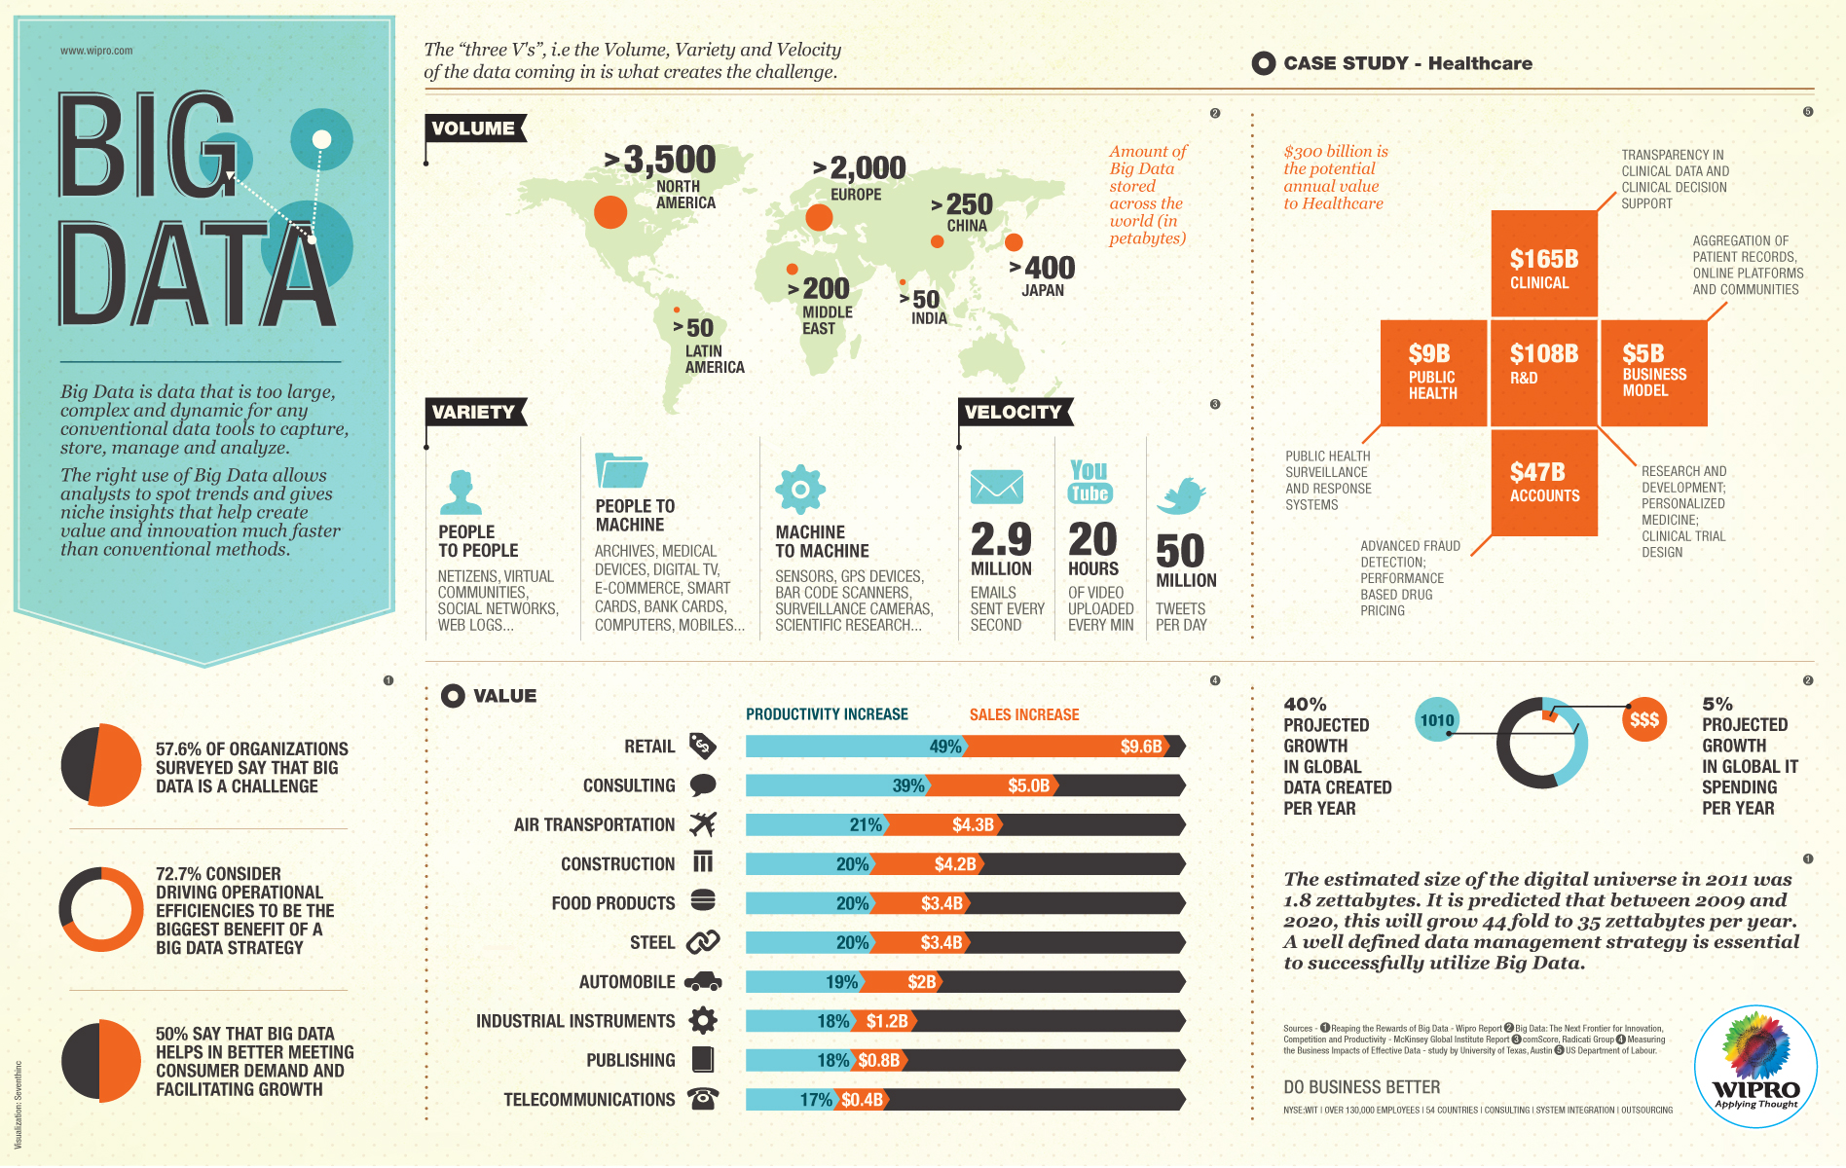
Volume, Variety, Velocity
http://thumbnails.visually.netdna-cdn.com/big-data_50291c3b16257.jpg

Slide 4
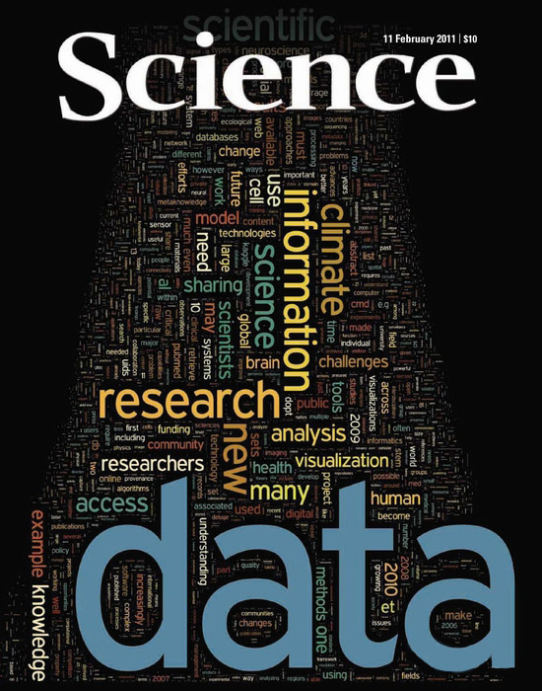
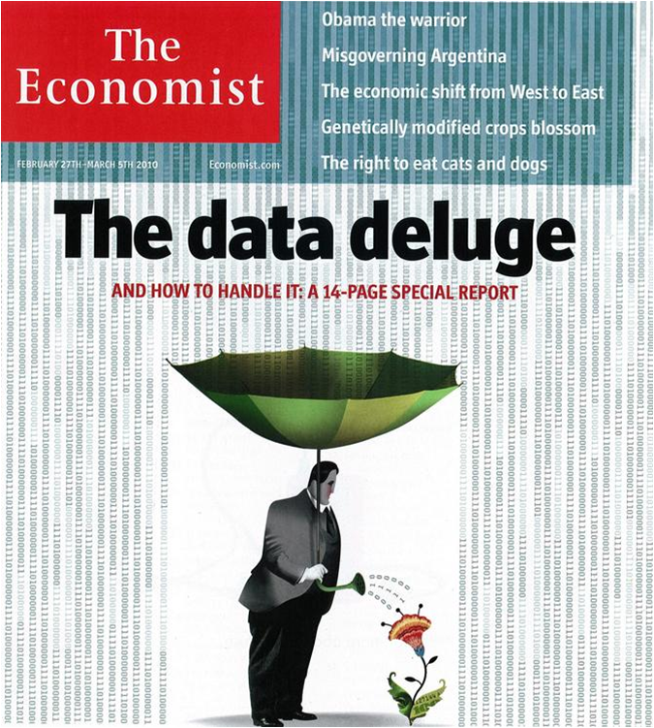
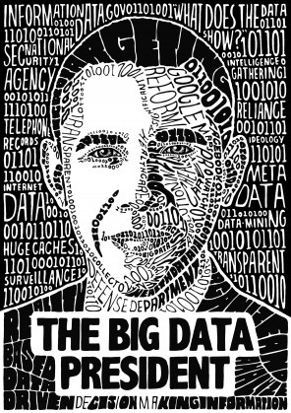
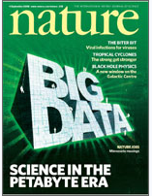
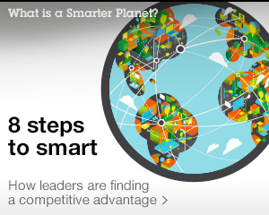
It is a hot topic

Slide 5

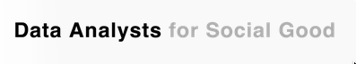
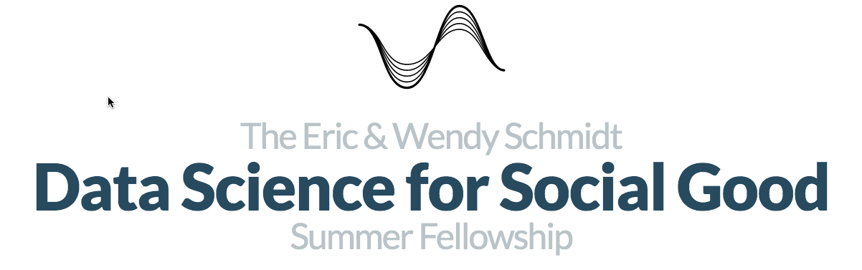
It is a hot topic

Slide 6
What is Big Data?

Slide 8
This makes it sound
like a challenge

Slide 9
Big Data is an opportunity!

Slide 10

Creating knowledge with computing
John von Neuman, Nicholas Metropolis, and Stanislaw Ulam
at Los Alamos National Lab

Slide 11
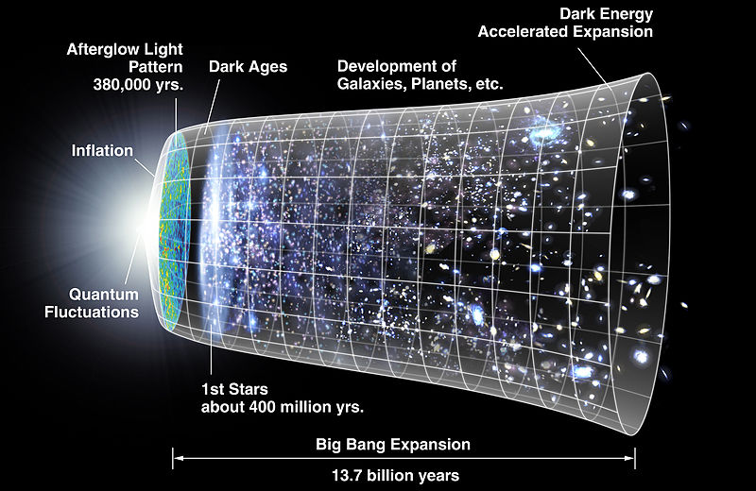

Evolution of the universe

Slide 12
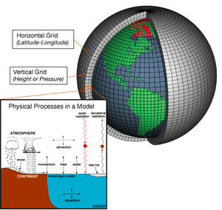
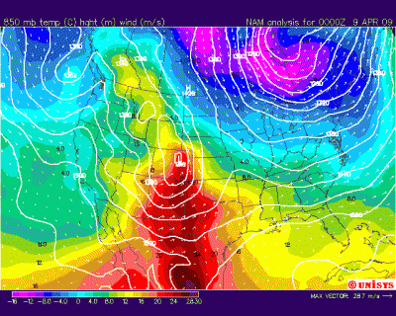
Forecasting the weather

Slide 13
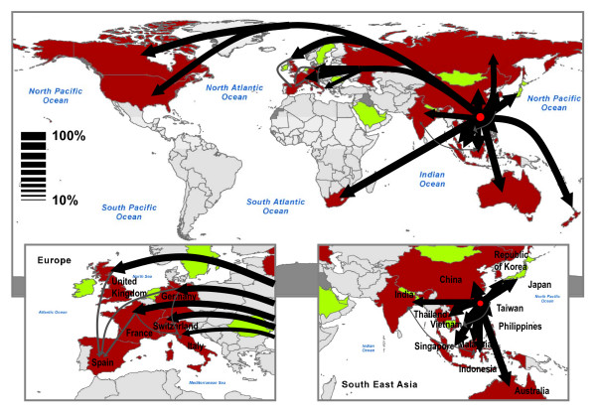
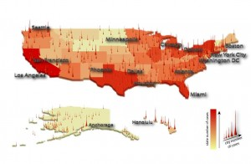
Modeling pandemics

Slide 14
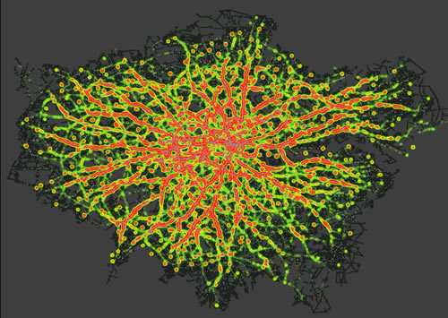
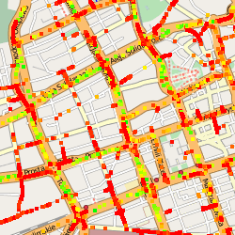
Forecasting traffic

Slide 15
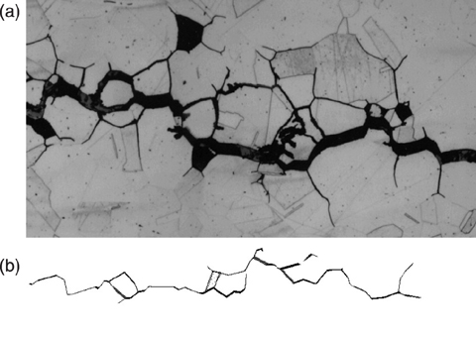
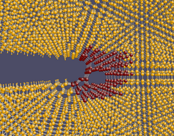
Understand material failure

Slide 16
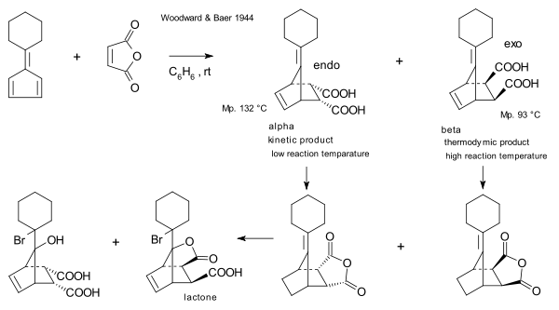
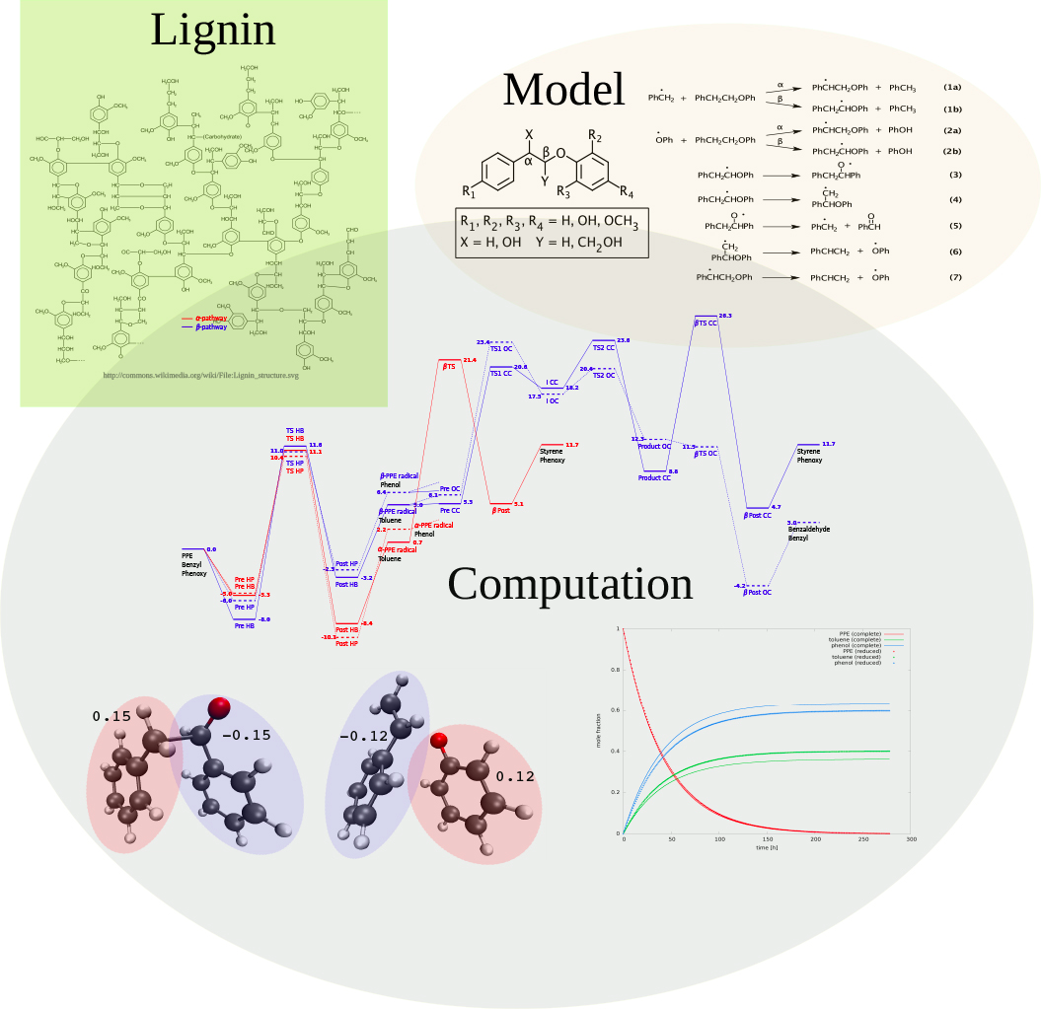
Uncovering new chemical reactions

Slide 17
Something else
is going on now

Slide 18

Vast seas of digital data
http://www.cleanbreak.ca/wordpress/wp-content/uploads/BigDataBigBuildings.jpg

Slide 19
…which may reveal hidden patterns
Data
Driven
Discovery

Slide 20

How can data driven discovery impact science and society?

Slide 21
Examples

Slide 22
Computers are key

Slide 23
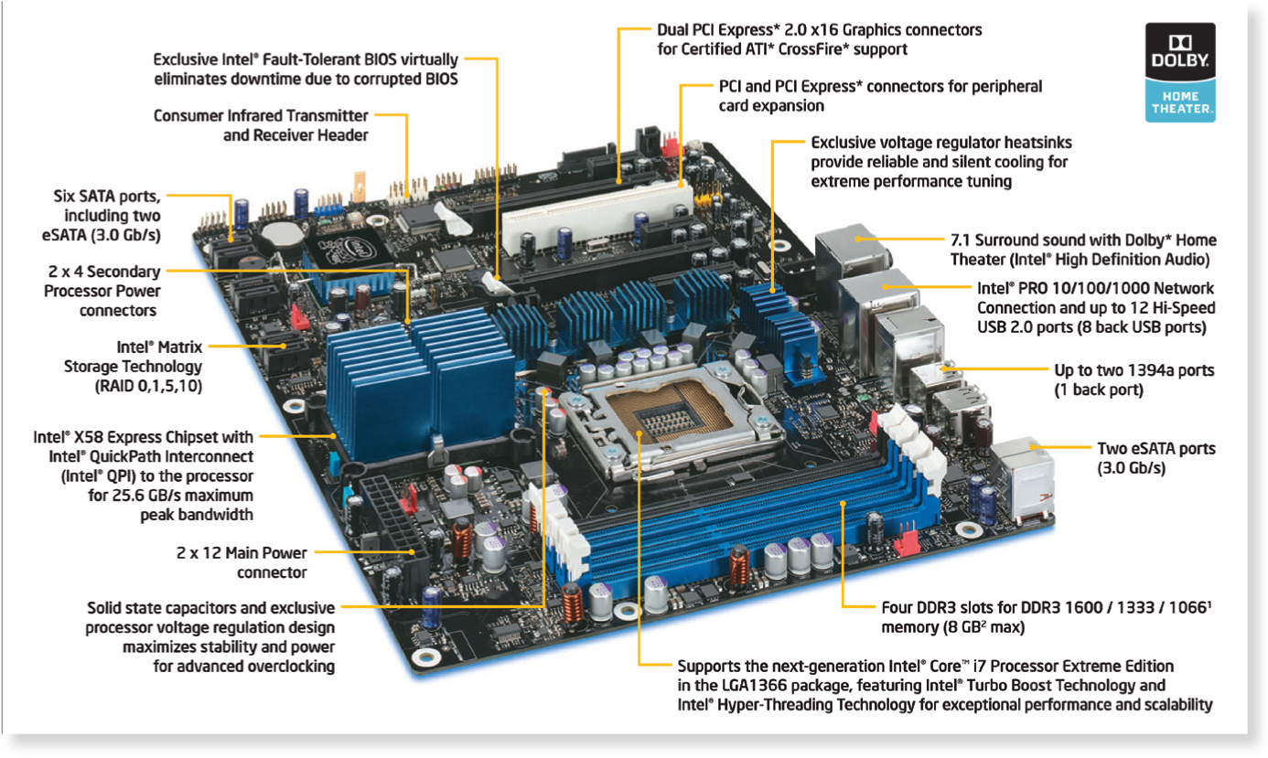
The hardware

Slide 24
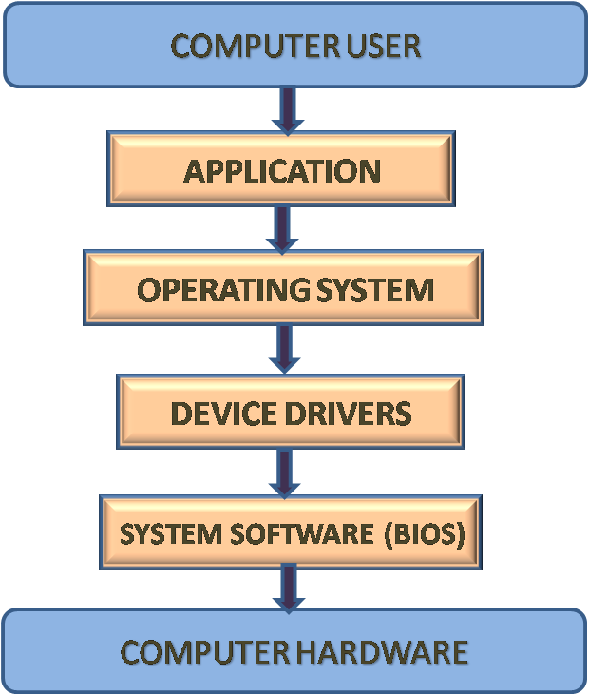
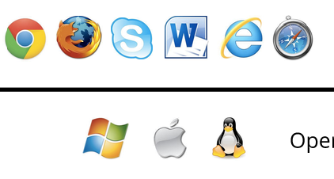

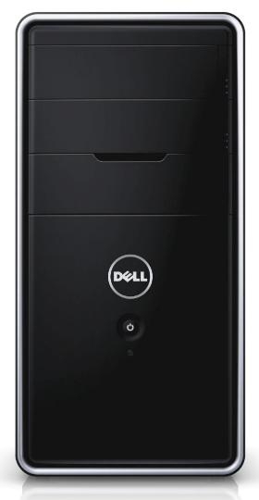
Writing your own applications

Slide 25
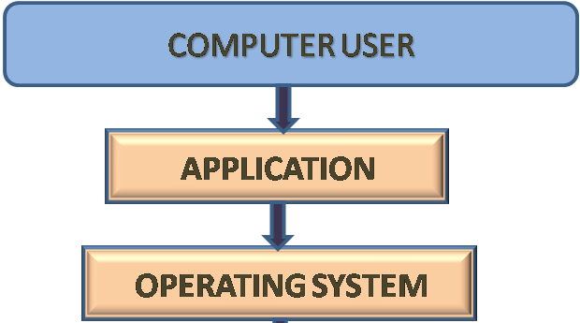
Writing your own applications
Need to understand:
Computer/cloud storage capabilities
Internal/external data transfer capabilities
Location of software and data

Slide 26
Why Python?

Slide 27
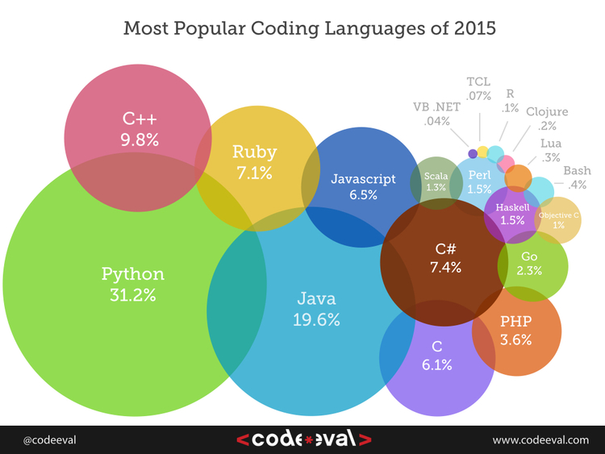
Employer needs
Results based on hundreds of thousands of data points collected by processing 600,000+ coding tests and challenges by 2,000+ employers.

Slide 28
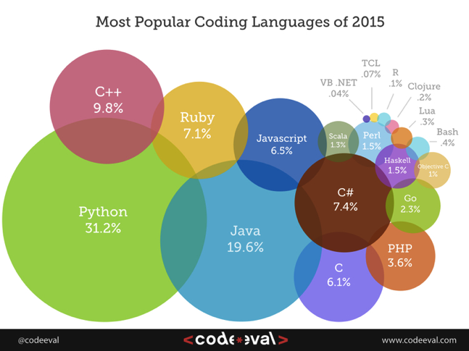
Employer needs
Growing:
C
C#
Javascript
Python
Shrinking:
C++ (20%)
Java (17%)
Perl
Ruby (28%)
Python top-ranked language fourth year in a row!

Slide 29
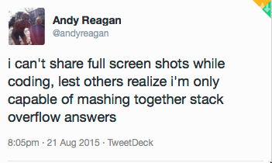
We all need help

Slide 30
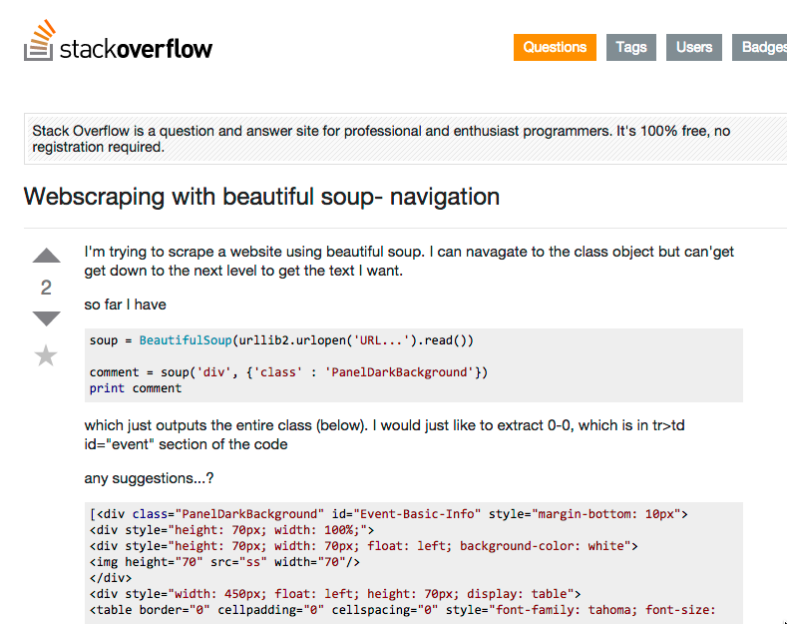
We all need help

Slide 31
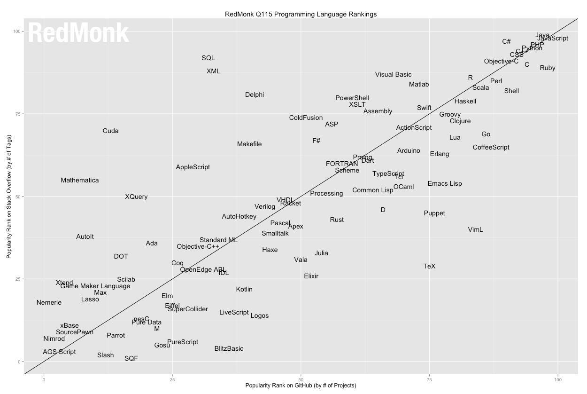
Developer activity
1. JavaScript
2. Java
3. PHP
4. Python
5. C#
5. C++
5. Ruby
8. CSS
9. C
10. Obj-C
11. Perl
11. Shell
13. R
14. Scala
15. Haskell
16. Matlab
17. Vis. Basic
StackOverflow
GitHub

Slide 32
Comparing languages
C: Simple, fast and flexible. Makes for smaller programs. (1989)
C++: Great for large complex projects because it is object-oriented. (1998)
FORTRAN: Very fast. Perfect for number crunching. (1966)
Javascript: Website development. (1997)

Slide 33
Comparing languages
Java: Multiplatform, portable. Similar to C++.
Mathematica: Symbolic calculations.
Matlab: Domain specific number crunching.
PHP: Scripting language for website development.
Python: Multi-purpose language. Highly-readable. Extremely flexible.

Slide 34
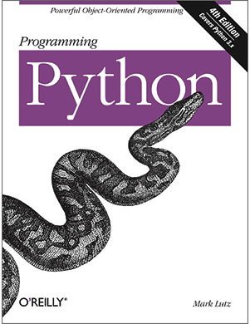

Python
Guido van Rossum
Language was named after Monty Python’s Flying Circus

Slide 35
Code is more often read than written
http://docs.python-guide.org/en/latest/writing/style/

Slide 36
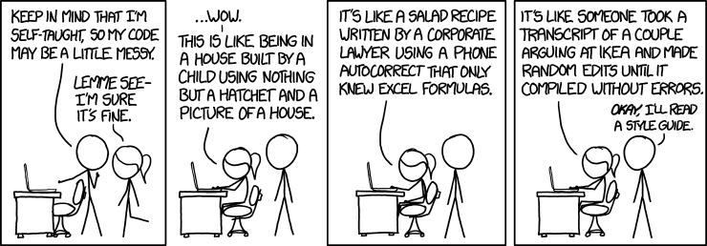

Slide 37
A high level of readability is at the heart of the design of Python
http://docs.python-guide.org/en/latest/writing/style/

Slide 38
One reason for Python code to be easily read and understood is its relatively complete set of Code Style guidelines and “Pythonic” idioms.

Slide 39
The Zen of Python
Beautiful is better than ugly.
Explicit is better than implicit.
Simple is better than complex.
Complex is better than complicated.
Flat is better than nested.
Sparse is better than dense.
Readability counts.
Special cases aren't special enough to break the rules.
Although practicality beats purity.
[…]

Slide 40
Python is
extremely flexible

Slide 41
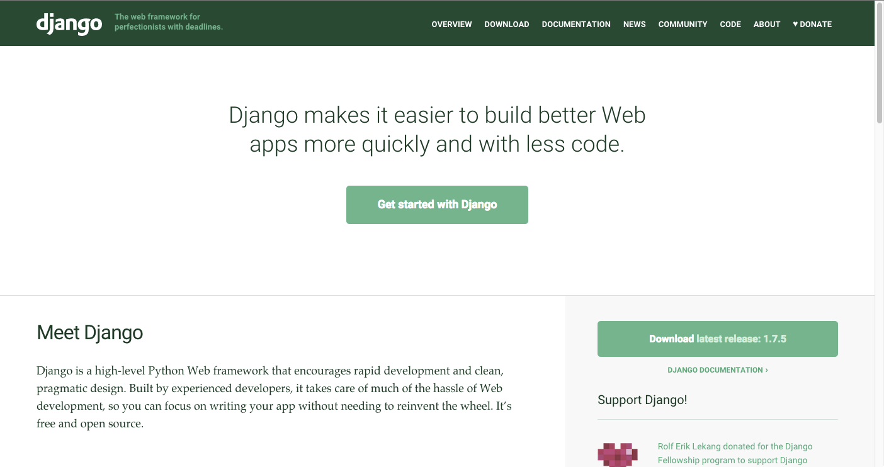
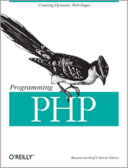
Web development

Slide 42
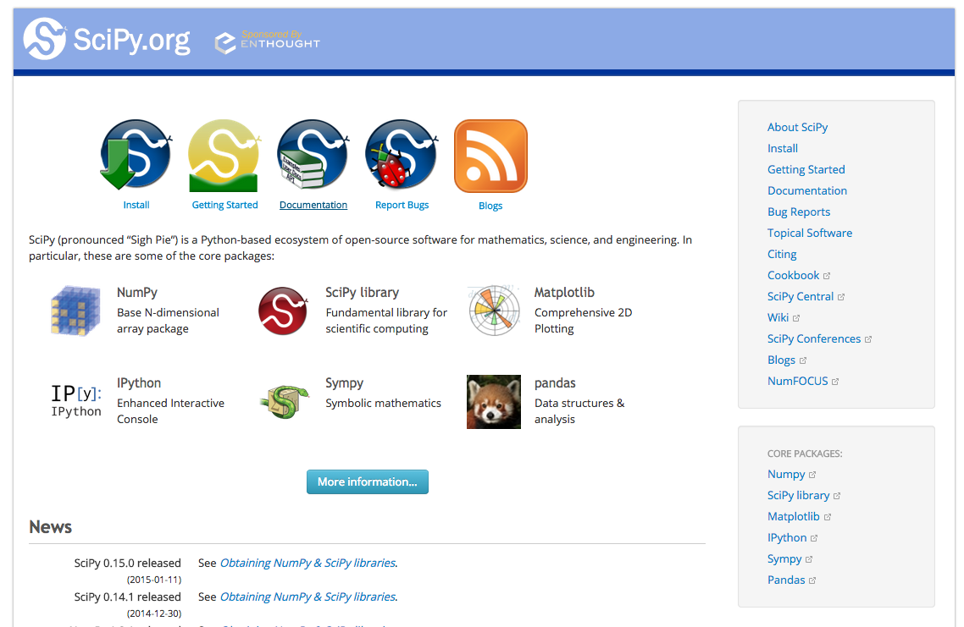

Scientific computing

Slide 43
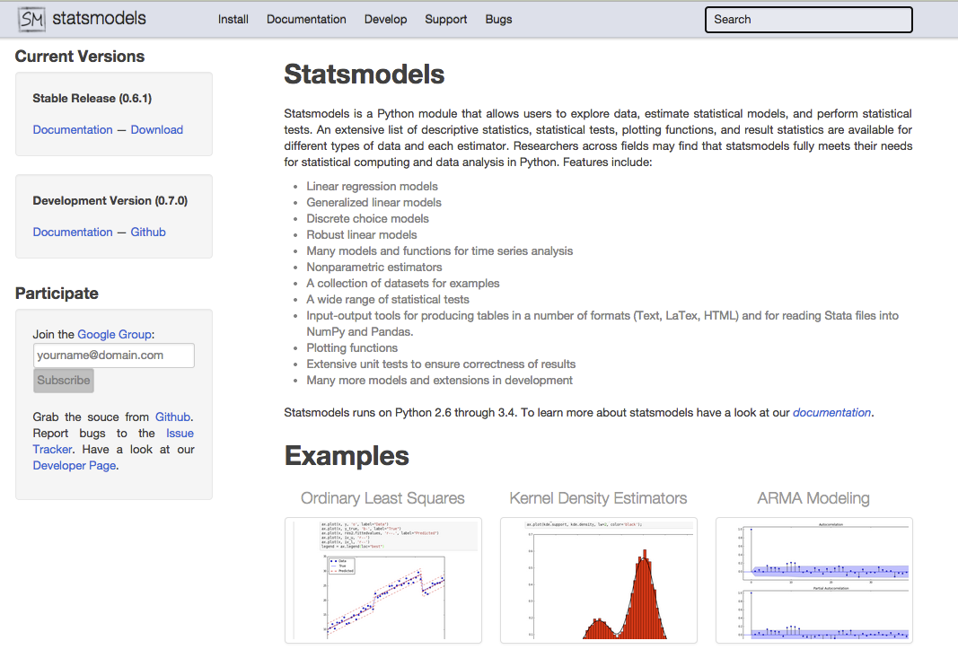
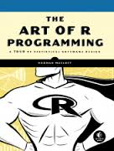
Statistical analysis

Slide 44
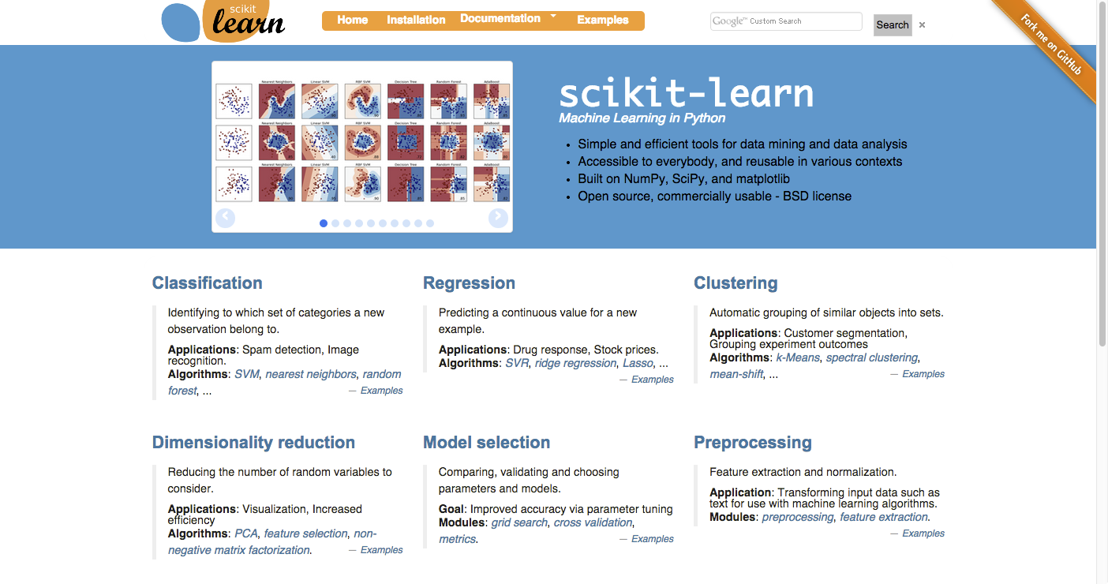
Machine learning

